Slide 1

Understanding loneliness
A data-driven analysis of the Canadian Social Connection Survey
Notes:
This is the “Title Slide Simon Fraser University” layout slide.

Slide 2

POWERPOINT TEMPLATE
General Instructions and Sample Slides
Notes:
This is the “Title Slide SFU” layout slide, the logo and red bar is locked. For more flexibility working with these elements see slides 7 and 8.

Slide 3
GENERAL INSTRUCTIONS
Notes:
This is the “Section Divider” layout slide.

Slide 4
How to use this template
The template uses SFU colours and Arial.
Text is preset to 24 and does not auto resize, including bullets.
To create a new slide click “New Slide” in the ribbon and choose a layout, or duplicate and customize any sample layout that starts on slide 11.
To add a footer date, note or slide number:
Click Insert/Header and Footer then configure as needed.
Advanced users can update the Master Slide.
To tidy slides that are out of alignment click Reset Slide to snap layout elements back to their correct location. (Desktop app only.)
Note: If you have altered the text style (e.g., applied bold to certain words), resetting the slide will remove any alterations.
To view guides click View/Grid and Guides/Guides. Keep smart guides on to assist layout
Notes:
This is the “Title and Content” layout slide.

Slide 5
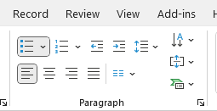
How to use bullets
Bullets are standard and change with each list level:
This is List Level 1
This is List Level 2
This is List Level 3
This is List Level 4
To change levels
Click the Indent More/Less buttons, or
Insert cursor at the beginning of the text, press TAB to increase or SHIFT+TAB to decrease
Manually adjust font sizes where appropriate
Remove bullets by clicking the Bullets button
Notes:
This is the “Title and Content” layout slide.

Slide 6
Type: Slide headers are bold and dark red
Subheads are bold and dark red
To style a subhead simply bold and set colour to dark red. Paragraphs are black and have set spacing between the lines and between paragraphs.
This is a bullet. To remove bullets click the Bullets button. All hyperlinks are underlined dark red for links and light red for visited links.
Adjust font size as needed and strive for consistency across all slides.
Captions are black and can be manually set to smaller font size. To insert a caption under a photo or on the side click Insert/Text Box. Ensure all text is Arial.
Notes:
This is the “Title and Content” layout slide.

Slide 7
Basic table
Column 1 | Column 2 | Column 3
Enter data here
Use Table Style options to add or remove banding
Use Table Style options to add or remove total row
Customize font sizes as needed
Notes:
This is the “Title only” layout slide with a table.
This layout includes a title placeholder. Here it is used to provide a sample table.
This sample table has:
Bold text for column headings with light gray shading (the lightest gray available in the SFU colour theme),
SFU dark red for gridlines, and
Left justified text.
Minimize gridlines for a cleaner look.
Note how the header row is wider than the rows in the table to help the headings stand out.

Slide 8
Freeform elements
The following slide has freeform elements that are not locked (to the Master Slides). Simply copy and paste as needed.
Notes:
This is the “Title and Content” master slide.

Slide 9
Analytic Sample Flow Chart
Survey participants n=11,545
2021
n = 3,555
2022 n = 3,890
2023 n = 2,974
2024 n = 1,126
Analytic Sample n = 8,260
Missing
Higher % of:
Non-student
Uneducated
Unemployed
White
Cis-het
Men
Exposure: 704
Outcome: 182
Both: 2,399
n = 3,285
Notes:
This is the “Title and Content” master slide.

Slide 10
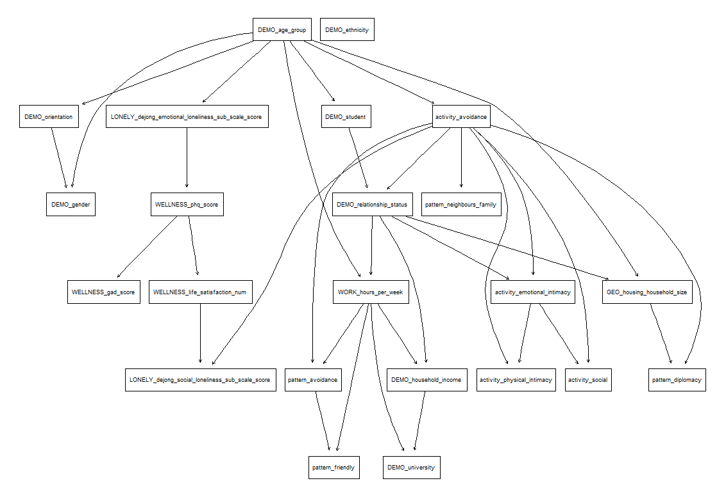
Notes:
This is the “Full Picture” layout slide.
This layout includes a picture placeholder that covers the slide.
To change a photo on a sample slide:
Right-click the photo, select Change Picture and then select an option (e.g., From Clipboard), or
You can delete the photo if it is in a picture placeholder then click on the picture placeholder to import a picture
To add a photo to a blank picture placeholder:
Click on the placeholder icon to upload a photo
Click on the placeholder, then go to Insert-Pictures to select “Insert Picture” from:
This Device
Stock Images
Online Pictures
Copy a picture (CTRL or CMD + C), click on the placeholder and paste (CTRL or CMD + V)

Slide 11
Notes:
This is the “Full Picture” layout slide.
This layout includes a picture placeholder that covers the slide.
To change a photo on a sample slide:
Right-click the photo, select Change Picture and then select an option (e.g., From Clipboard), or
You can delete the photo if it is in a picture placeholder then click on the picture placeholder to import a picture
To add a photo to a blank picture placeholder:
Click on the placeholder icon to upload a photo
Click on the placeholder, then go to Insert-Pictures to select “Insert Picture” from:
This Device
Stock Images
Online Pictures
Copy a picture (CTRL or CMD + C), click on the placeholder and paste (CTRL or CMD + V)

Slide 12



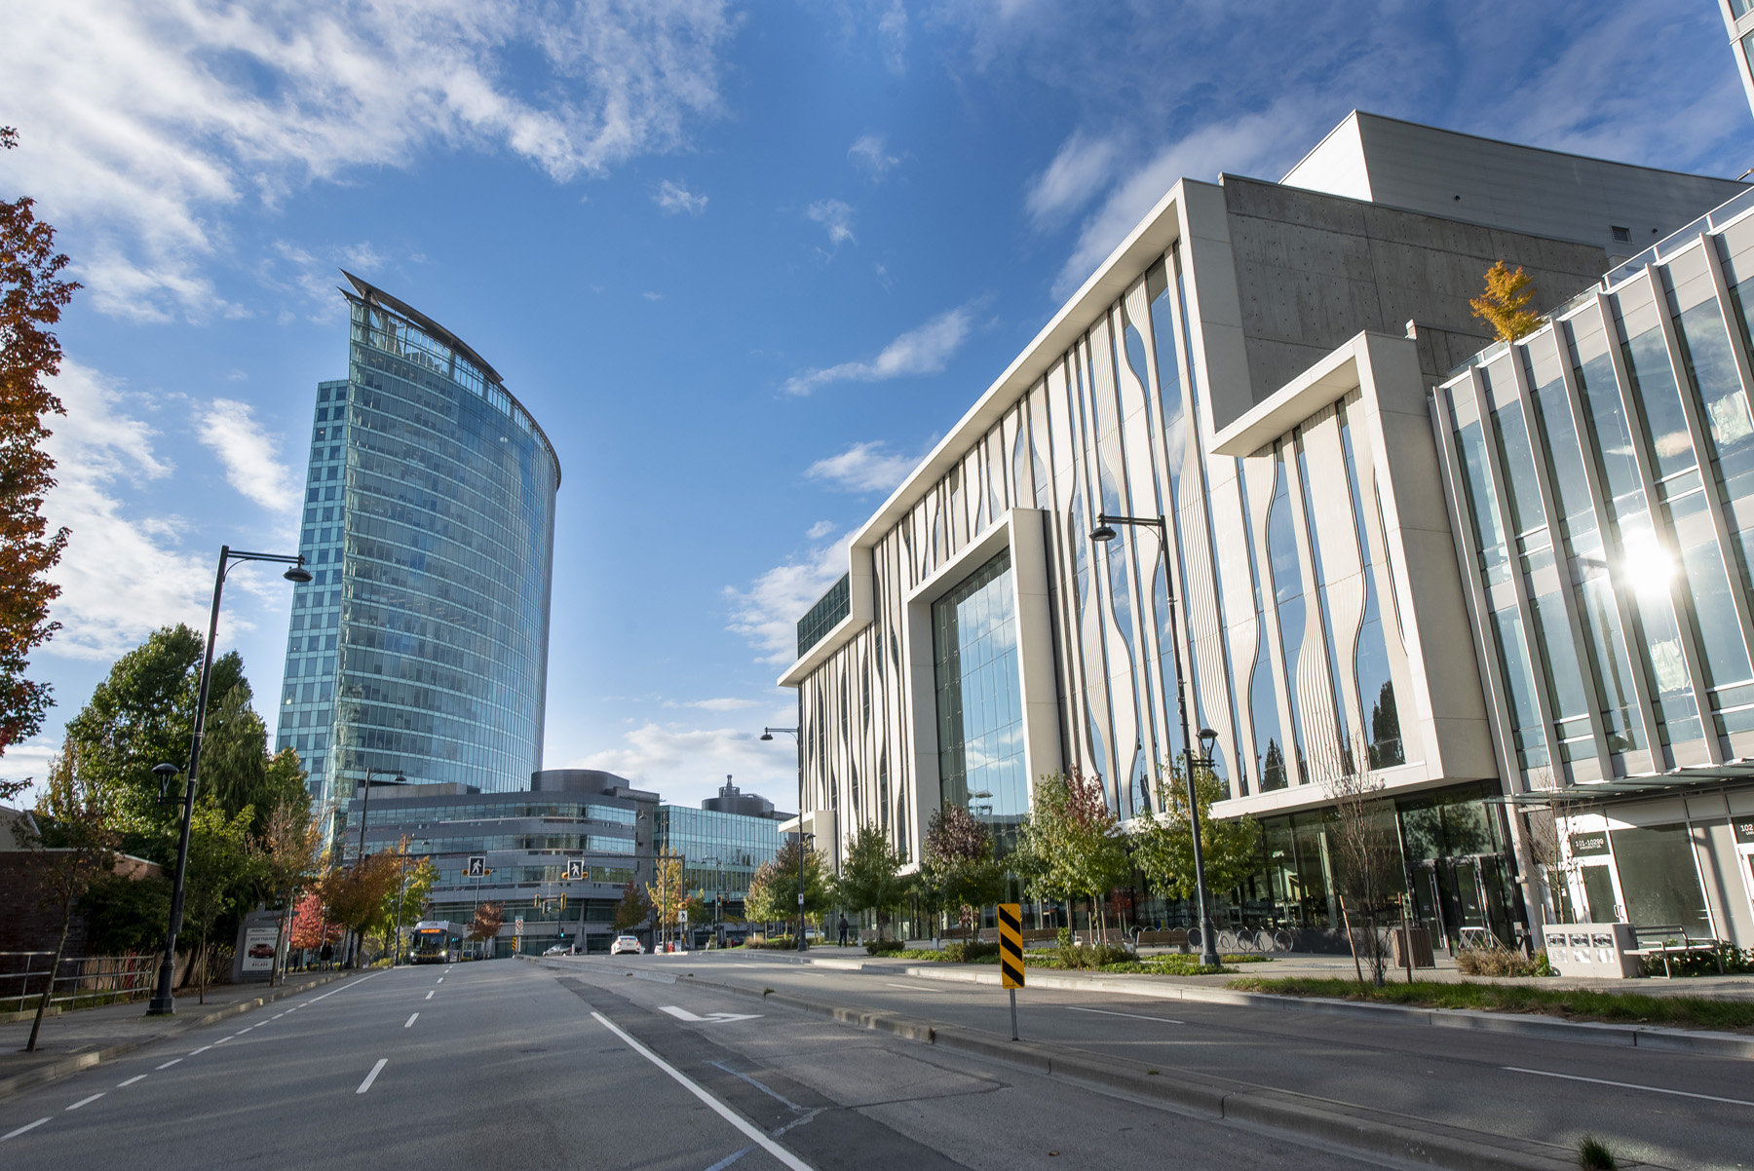


Red box
Grey box
Presentations viewed outside British Columbia should use logos with “Simon Fraser University”. SFU logos should be aligned with the left or top edge as mocked here.
To change a photo right-click then select change picture. SFU photos look best when bleeding off the edge. To crop or resize a photo within its containter right click then select Crop. Move the corner handles or the image itself.
Notes:
This is a blank page with freeform elements.

Slide 13



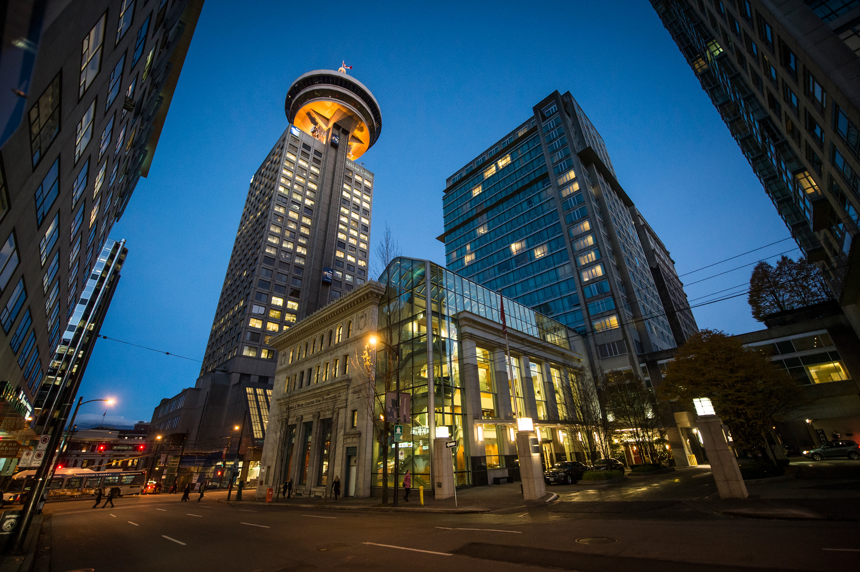
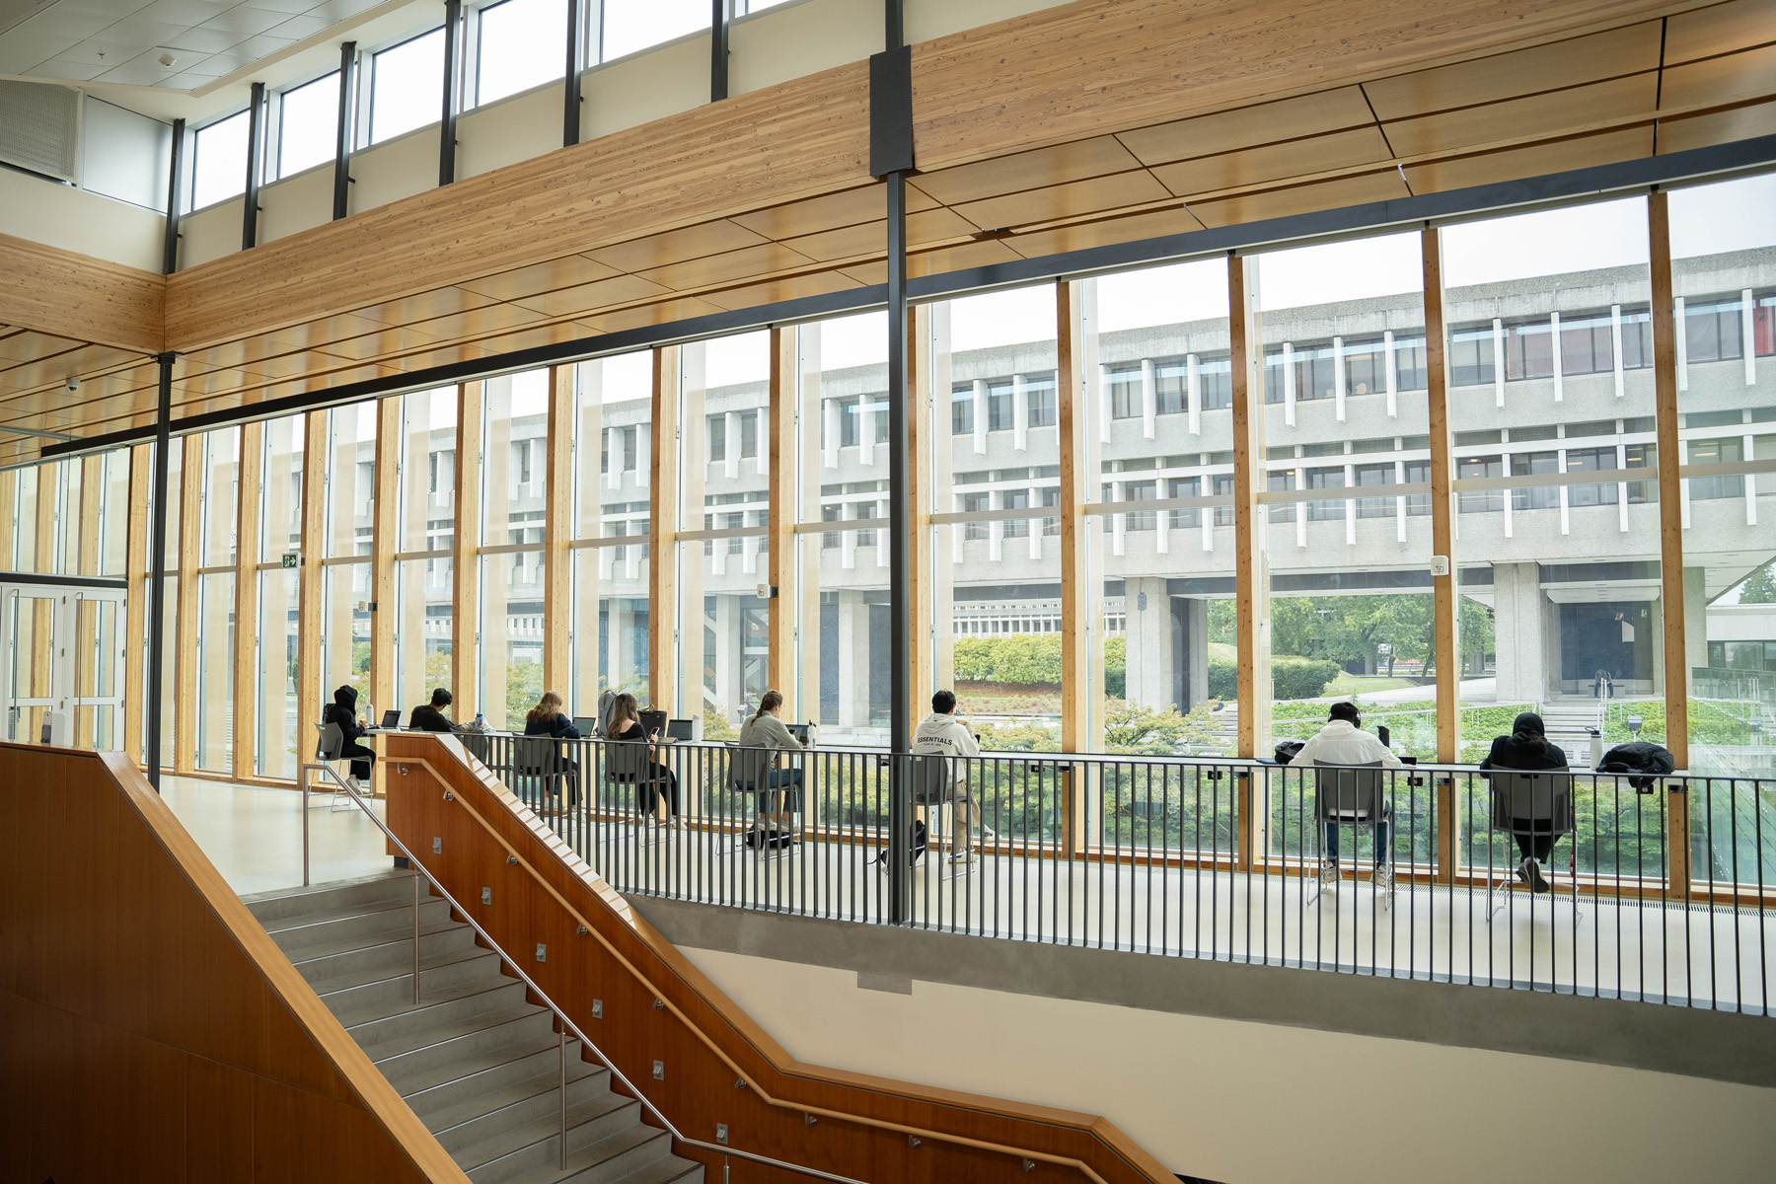

Sample photos
Notes:
This is the “Title Only” layout slide with sample photos added.
This layout is also useful for adding tables, charts, graphs, or other graphic elements.

Slide 14
SAMPLE SLIDES
Notes:
This is the “Section Divider” master slide.

Slide 15
Presentation Title
Presentation Subtitle or Date
Notes:
This is the “Title Slide SFU ALT” layout slide

Slide 16
Presentation Title
Presentation Subtitle or Date
Notes:
This is the “Title Slide Simon Fraser University ALT” layout slide

Slide 17
Presentation Title
Presentation Subtitle or Date
Notes:
This is the “Title Slide SFU” layout slide.

Slide 18
Divider Slide
Notes:
This is the “Divider” layout slide.
You can also add sections in PowerPoint by right-clicking on the slide thumbnail and selecting Add Section. This option is only available on the desktop app.

Slide 19
Divided content and picture
SFU photos look best bleeding off the edges like this example.
Notes:
This is the “Divided Content and Picture” layout slide.

Slide 20
Title and content
To remove bullets select text then click “Bullets”
Subhead
Reminder subheads are simply bold and dark red.
Notes:
This is the “Title and Content” layout slide.

Slide 21
Title with red bar
Add copy here.
Notes:
This is the “Title and Content with Subtitle and Red Band” layout slide
This layout includes a title placeholder and a content placeholder.
This layout has a red band behind the title.

Slide 22
Single phrase or quote slide (wide)
Notes:
This is the “Single Quote or Phrase (Wide)”layout slide.
Use this layout for a single quote or phrase that spans the width of the slide (within the slide margins.)

Slide 23
Single phrase or quote slide (narrow)
Notes:
This is the “Single Quote or Phrase (Narrow)” layout slide.
Use this layout for a single quote or phrase that spans half the width of the slide and is centered.

Slide 24



Three columns with icons
Subhead
Subhead
Subhead
Subheads can be set in their own text box and “float” like this example.
Style this content in paragraph form…
…or in bullet form.
To change icons right click and select Change Graphic.
Notes:
This is the “Title and Content with Subtitle and Red Band” layout slide.
This layout includes a title placeholder, three subheaders and three content placeholders.
This layout has a red band behind the title.

Slide 25
Two columns
To remove bullets and use plain text, click on the bullets icon to deselect
Two columns help break up long
Notes:
This is the “Two Content” layout slide.
This layout is useful for breaking up heavy text into two columns.
Bullets are preset and start with a dot for level 1, a dash for level 2, and an open circle for level 3.
To turn bullets off, deselect the bullet icon in the Paragraph menu on the toolbar.

Slide 26
Notes:
This is the “Full Picture” layout slide.
This layout includes a picture placeholder that covers the slide.
To change a photo on a sample slide:
Right-click the photo, select Change Picture and then select an option (e.g., From Clipboard), or
You can delete the photo if it is in a picture placeholder then click on the picture placeholder to import a picture
To add a photo to a blank picture placeholder:
Click on the placeholder icon to upload a photo
Click on the placeholder, then go to Insert-Pictures to select “Insert Picture” from:
This Device
Stock Images
Online Pictures
Copy a picture (CTRL or CMD + C), click on the placeholder and paste (CTRL or CMD + V)

Slide 27
Photo with text overlay
Notes:
This is the “Full Picture with Text Overlay” layout slide.
This layout includes a picture placeholder that covers the slide. The text overlay box spans the width of the slide but restricts text within the margins.
To change a photo on a sample slide:
Right-click the photo, select Change Picture and then select an option (e.g., From Clipboard), or
You can delete the photo if it is in a picture placeholder then click on the picture placeholder to import a picture
To add a photo to a blank picture placeholder:
Click on the placeholder icon to upload a photo
Click on the placeholder, then go to Insert-Pictures to select “Insert Picture” from:
This Device
Stock Images
Online Pictures
Copy a picture (CTRL or CMD + C), click on the placeholder and paste (CTRL or CMD + V)

Slide 28
Thank you
Notes:
This is the “Divider” layout slide.
This file was last updated 20250402.

